Slide 1
GH Archive Data Analysis
Analyzing the type of events that happened on 13th July 2020 - the number of issues that were created and the average number of issues that were opened or closed on this day.
By: Vithika Agrawal

Slide 2
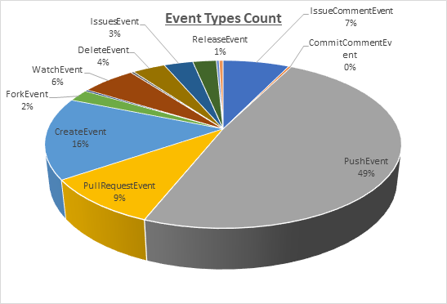
Analyzing the Type of Events executed
On 13th July 2020, i.e. on a Monday, most of the users have pushed their data into the repositories.
This day’s activity suggest that 49% of users were engaged in pushing their data into their repositories, followed by 16% of users creating new repositories.

Slide 3
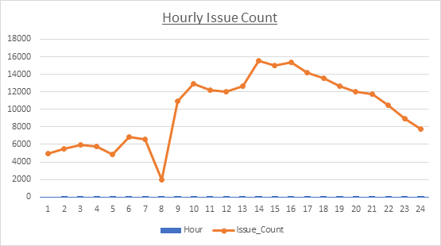
Analysing the number of issues raised per hour
This trend suggests that most people raise their issues during their official working hours
On Monday, most of the issues that were raised in Github were in between 9:AM - 6:PM with maximum issues raised at 2:00PM

Slide 4
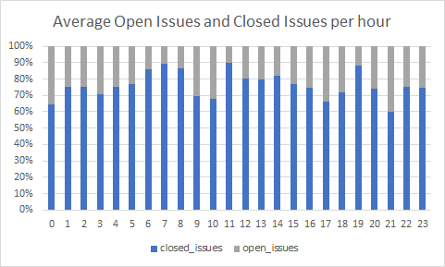
Analysing the Open/ Closed Issues per hour
At 11:00 AM, 90% of issues that were created by the users before were closed.
This graph suggests that more than 60% of the issues that were raised on an average were resolved within a day’s time.

